Slide 1
Biotouch
Biometric Systems
Computer Science,
La Sapienza
12/02/2018
Luca Moschella
Federica Spini

Slide 2
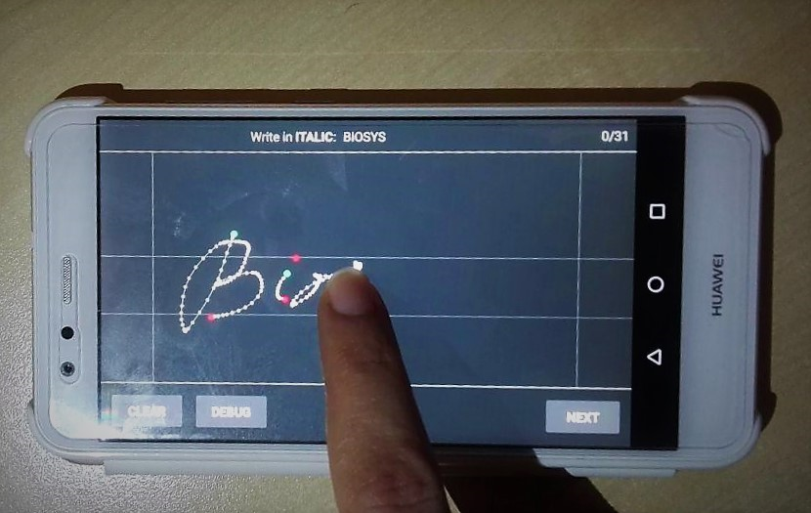
What is it?
A system capable to recognize users by their writing style on a touchscreen

Slide 3
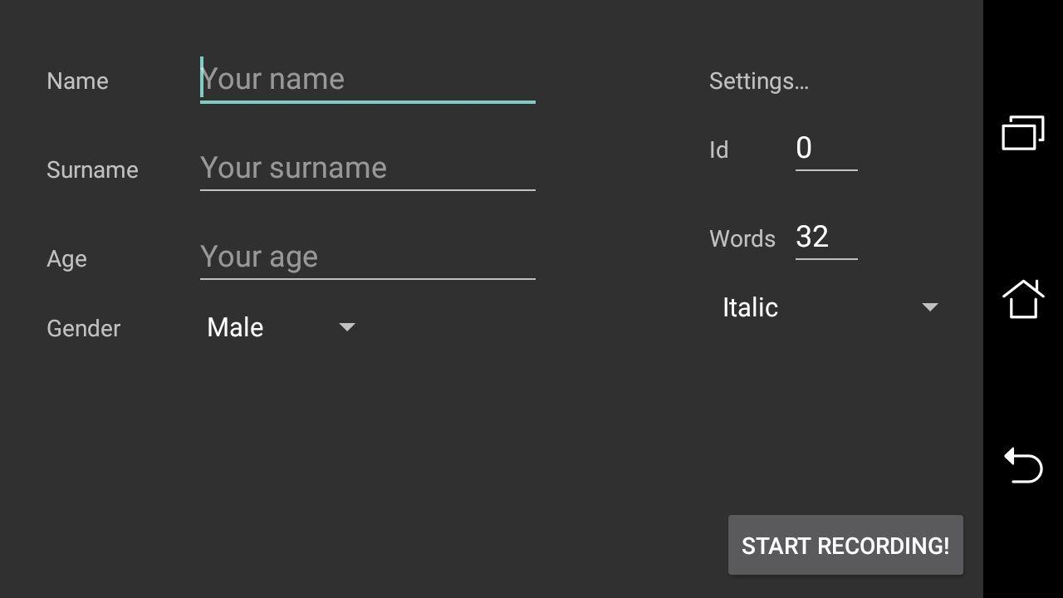
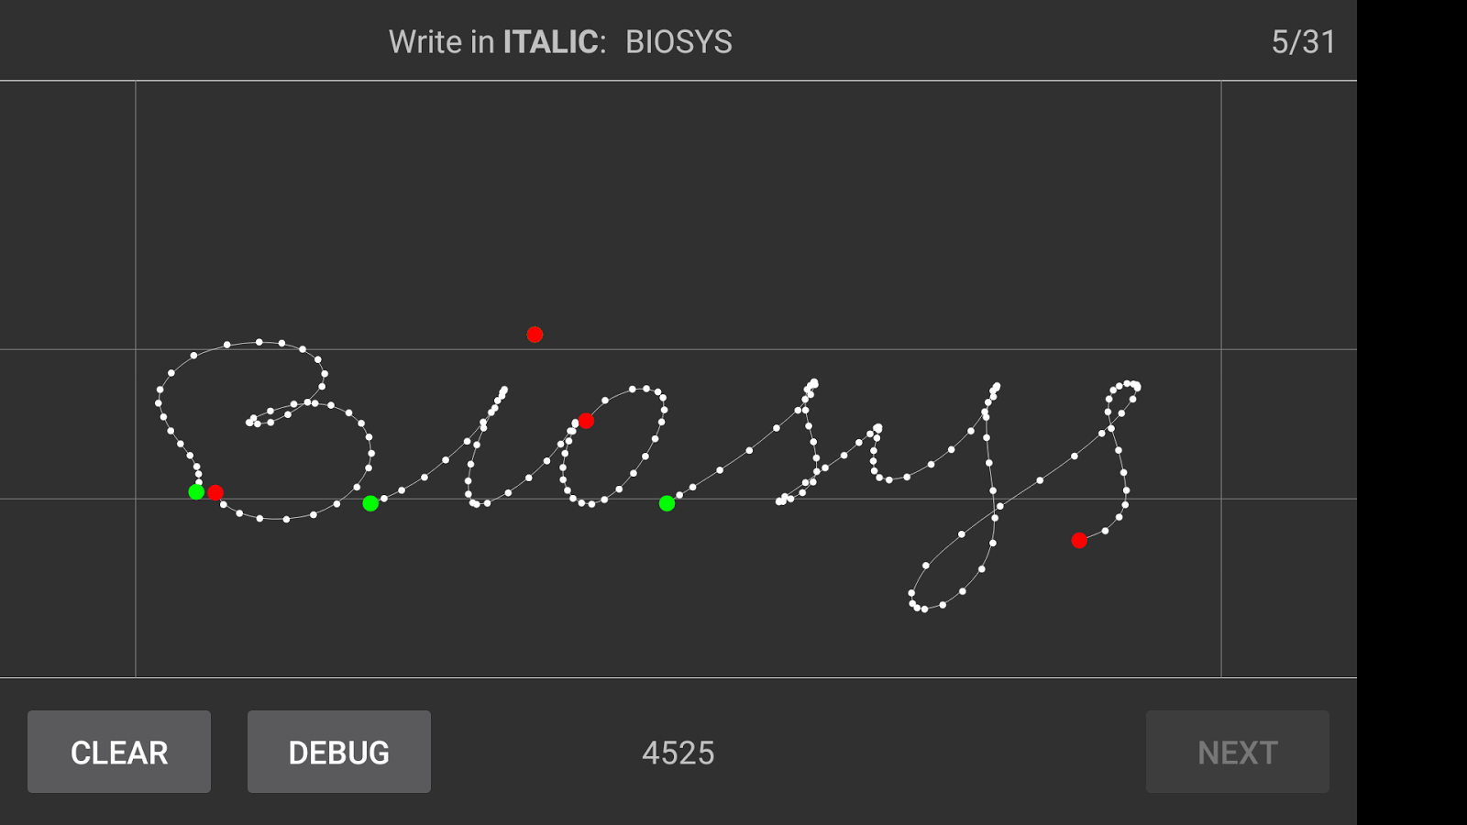
How did we gather the data?
We have built a simple painting android application to memorize the needed data
To memorize user information
To memorize how the word is written
We asked to 32 user to record 32 words in Italic and 32 words in block letters

Slide 4
What is it saved of a word?
Connected Component
Green points: the points in which the finger start touching the screen, the touch-down points
White points: the points that are sampled by the application while the finger is moving, the movement points
Red points: the points from which the user lifts the finger from the screen, the touch-up points

Slide 5
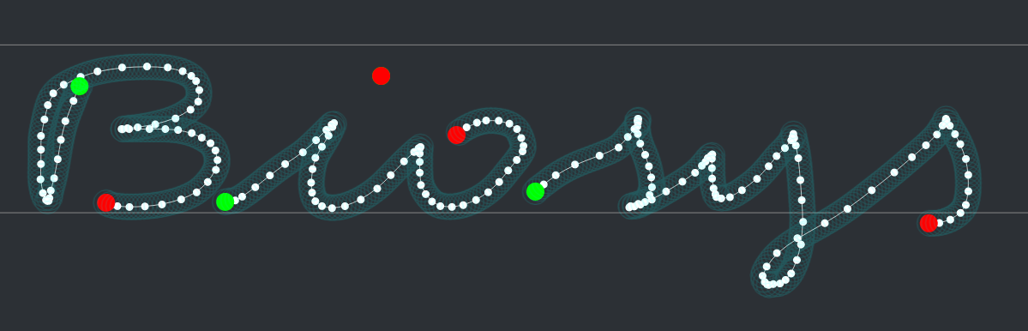
What is the line displayed?
The movements points are approximated by a quadratic Bezier curve, in order to give a feedback to the user.
Afterwards this Bezier curve is sampled each 5 pixel and these points are the sampled points.
In this system we didn't use the sampled points

Slide 6
What is it saved of each point?
The movement points, the touch-down points and the touch-up points are time series.
For each point in these time series we have these information:
The coordinates (x,y) of the point
The connected component of the word that the point belongs to
The time elapsed since the beginning of the recording (obvious, they’re time series)

Slide 7
How are the information of a single word organized?
This file name represents the word
User1.BLOCK LETTERS.0.json
Timestamp
Session ID
Handwriting style
Device model
User ID
Name and surname
Age
Gender
Movement points list (is a time series)
Touch up point list (is a time series)
Movement point 0
"time": 0
"component": 0
"x": 266.0
"y": 465.0
Movement point 1
Touch up point 0
"time": 169
"component": 0
"x": 277.0
"y": 618.0
Touch up point 1
Movement point 2
Touch up point 2
Movement point n
Touch up point n_{touch up}
Sampled points list (is NOT a time series)
Touch down points list (is a time series)
Sampled point 0
"x": 266.0
"y": 465.0
Sampled point 1
Touch down point 0
"time": 0
"component": 0
"x": 266.0
"y": 465.0
Touch down point 1
Sampled point 2
Touch down point 2
Samples point n_{sampled}
Touch down point n_{touch down}

Slide 8
How is the dataset organized?
Dataset
User1
Session id =0
Session id =1
BLOCK LETTERS
ITALIC
User1.BLOCK LETTERS.0.json
User1.BLOCK LETTERS.0.png
User1.BLOCK LETTERS.1.json
User1.BLOCK LETTERS.1.png
User1.BLOCK LETTERS.31.json
User1.BLOCK LETTERS.31.png
Session id =n
User2
User3
User32

Slide 9
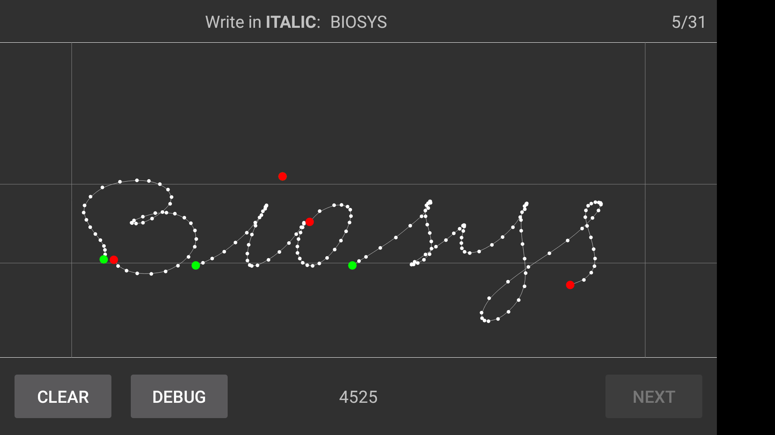
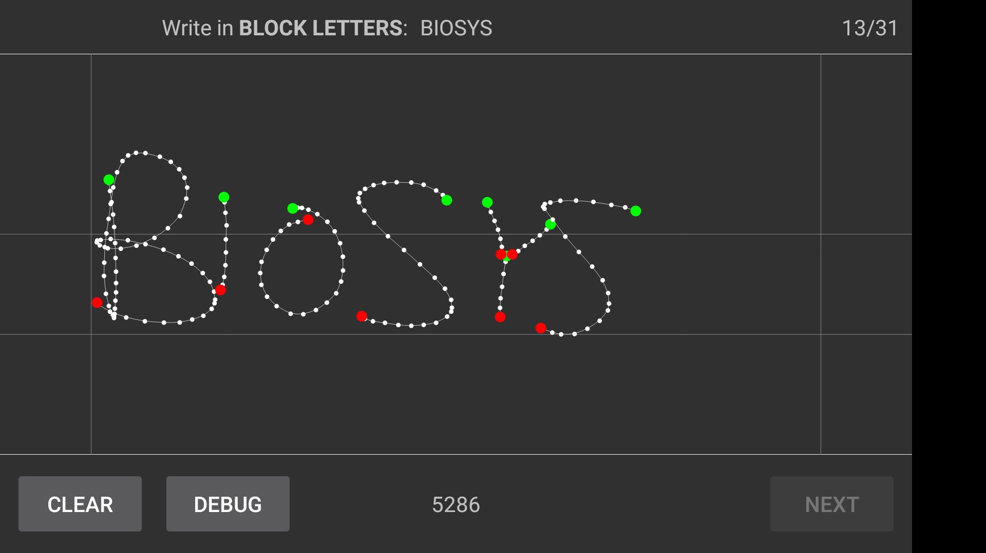
Are these information enough?
Given words written on the touchscreen with the application:
Can we reconstruct these written words, given only the information stored?

Slide 10
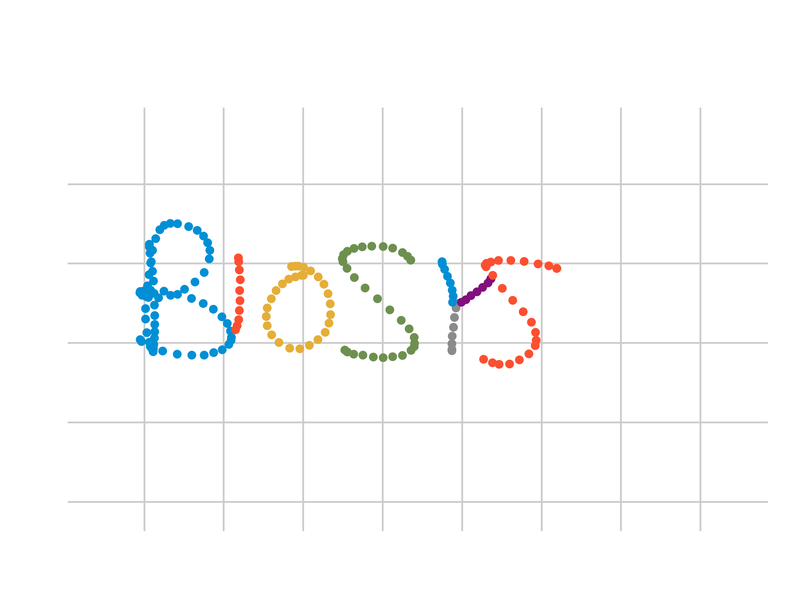
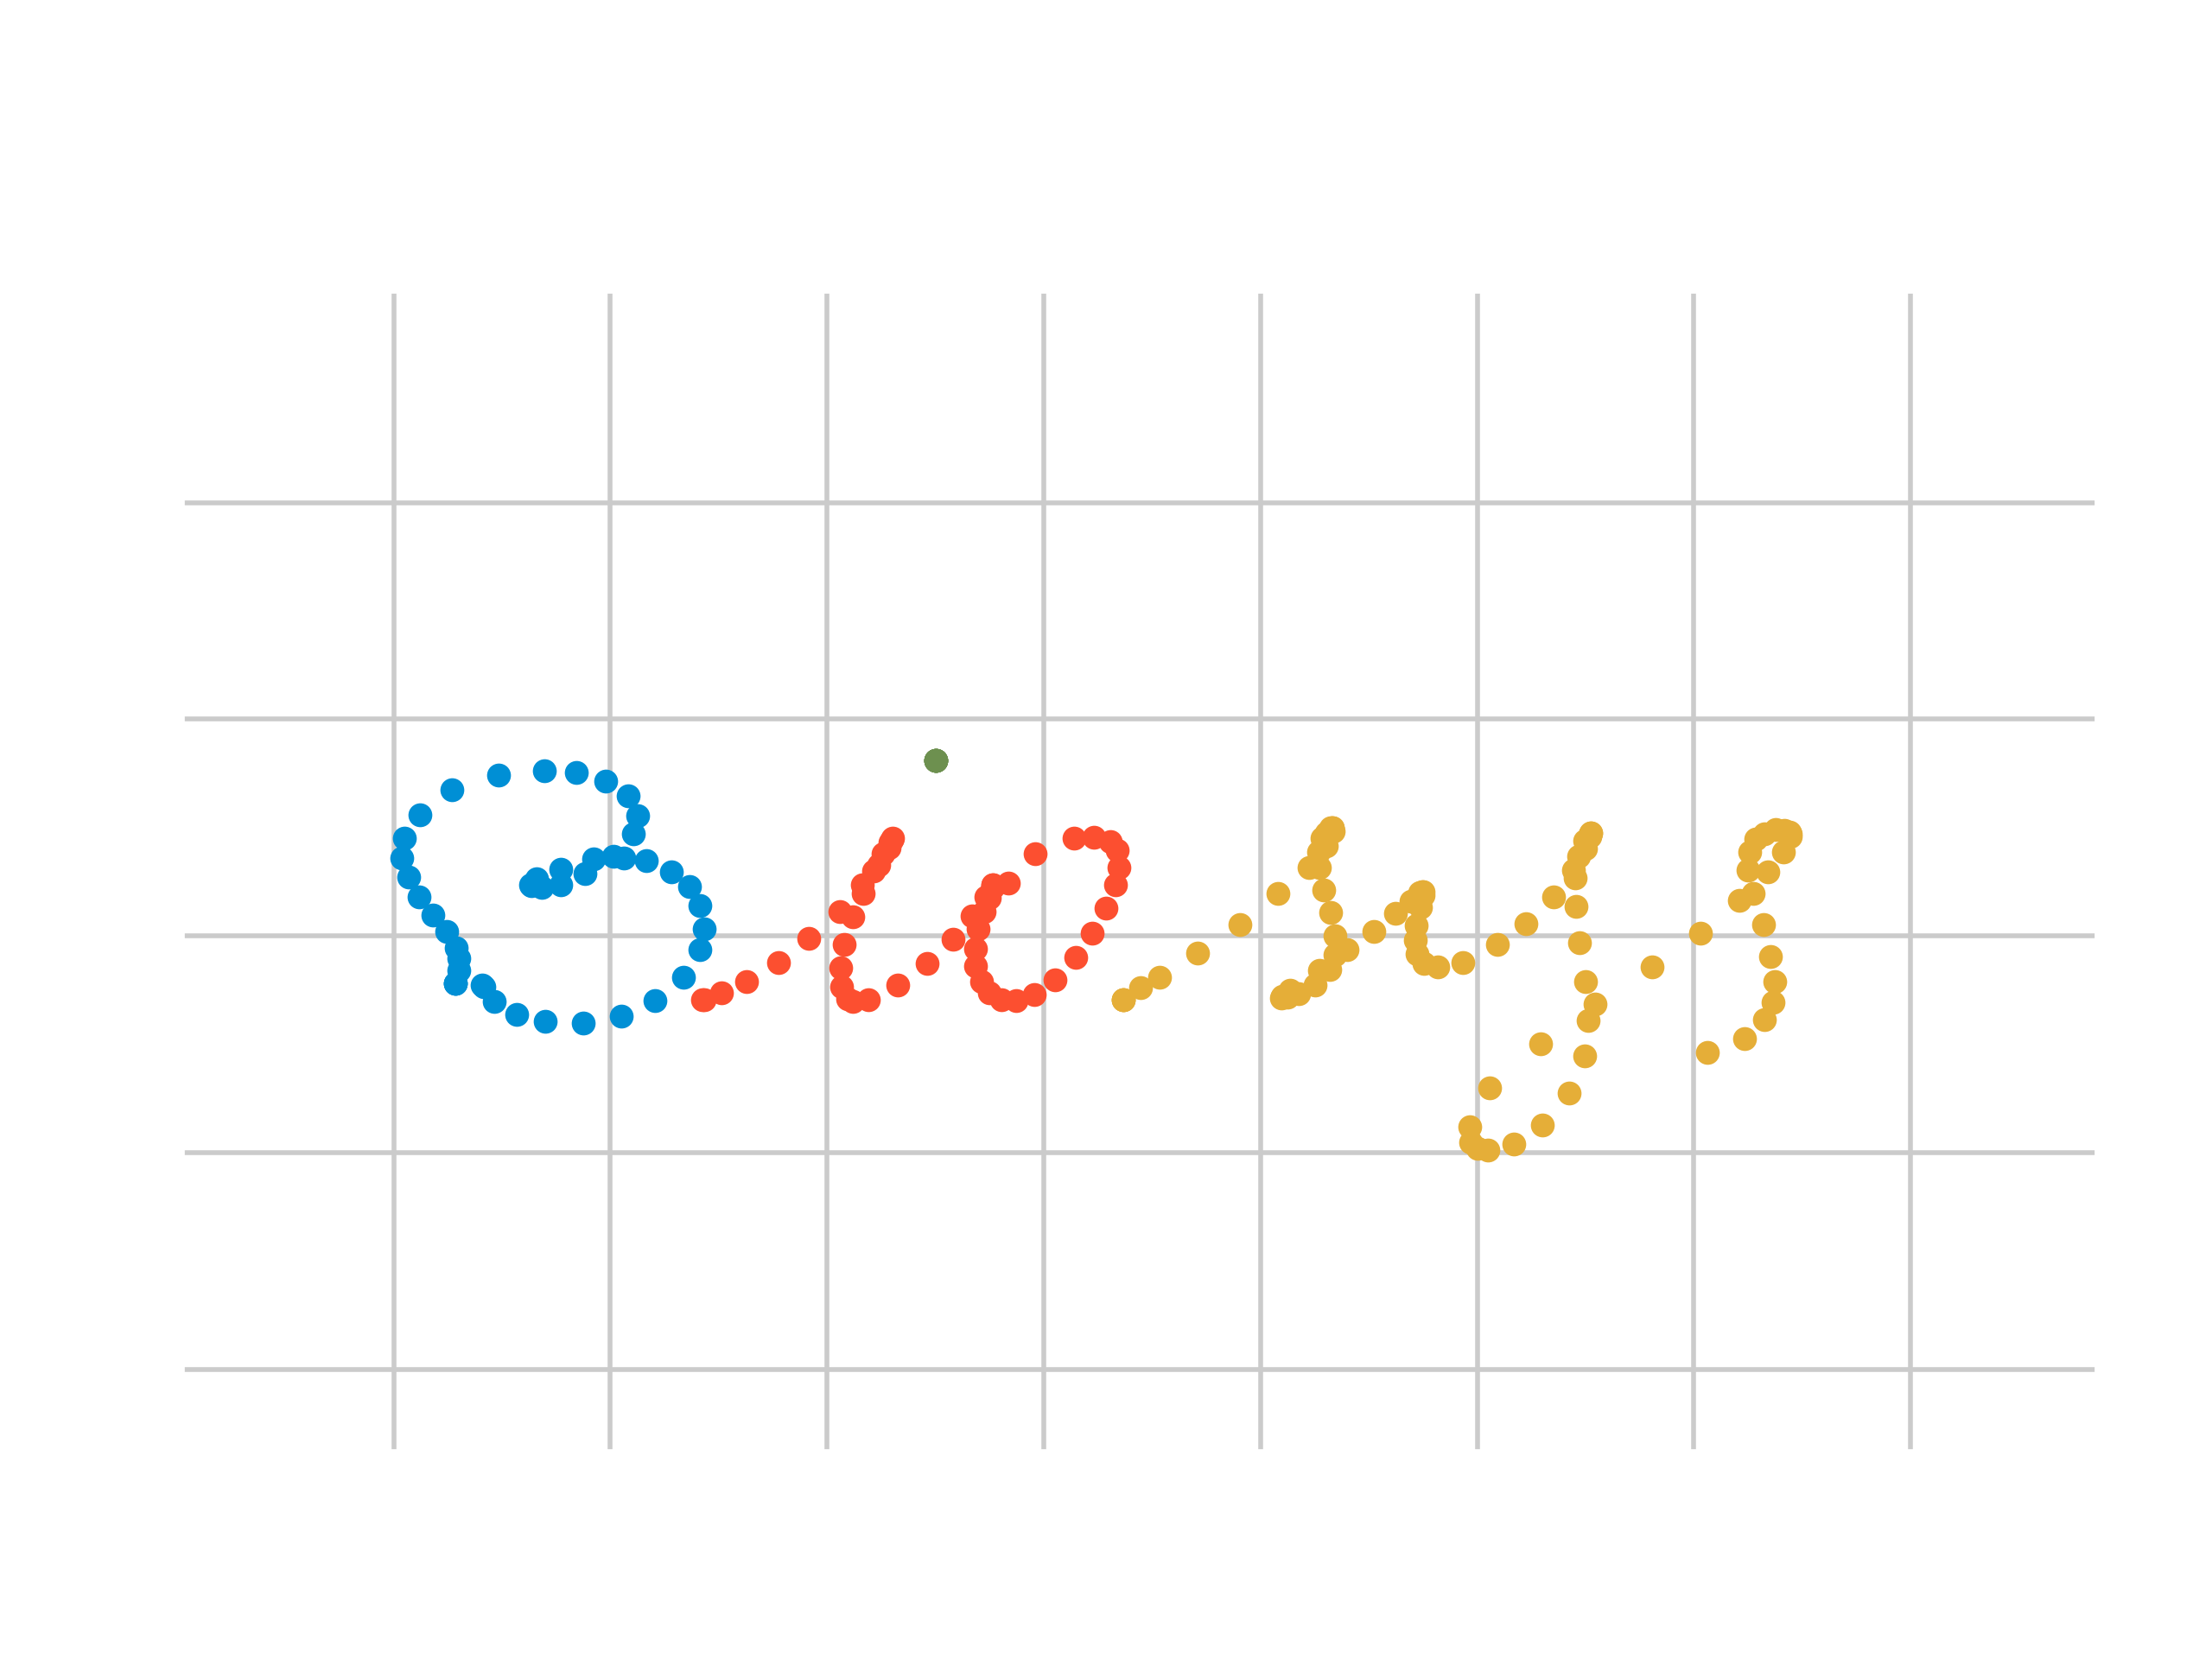
Yes, they are enough!
…we have also an exact distinction of the connected components!

Slide 11
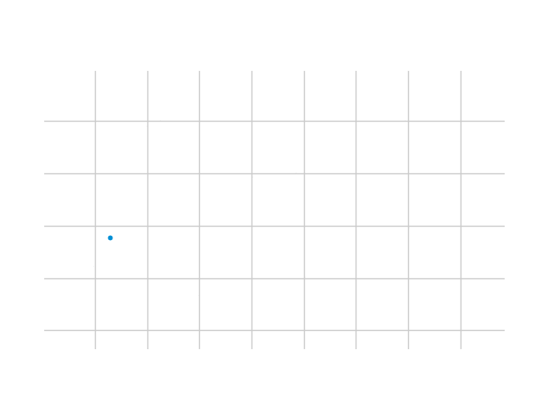
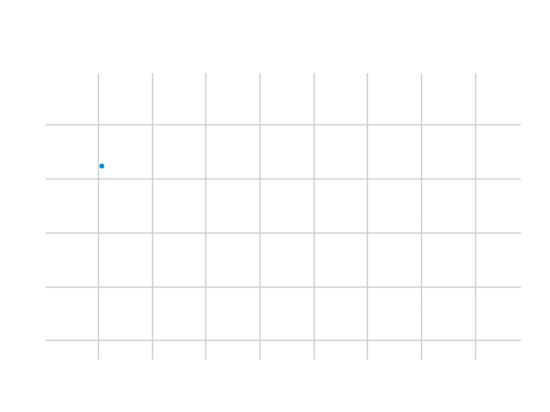
Moreover…
…we can reproduce the exact way the word was written, with its pauses and with its connected component order!

Slide 12
What does it mean?
We can analyze the written word… avoiding all the problems related to image recognition!
Furthermore of each point we know:
The elapsed time
The connected component it belongs to
These information cannot be learned from an image, neither by a human.

Slide 13
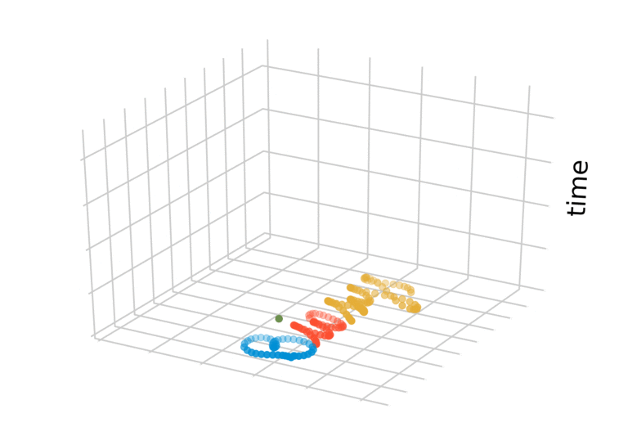
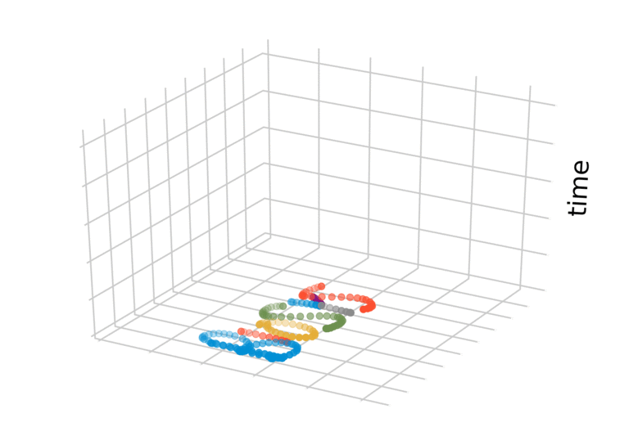
Time visualization on a 3D plot
Time gives a lot of information about the word: just look at the dot of the i, how the Y is decomposed or how the B is unrolled.

Slide 14

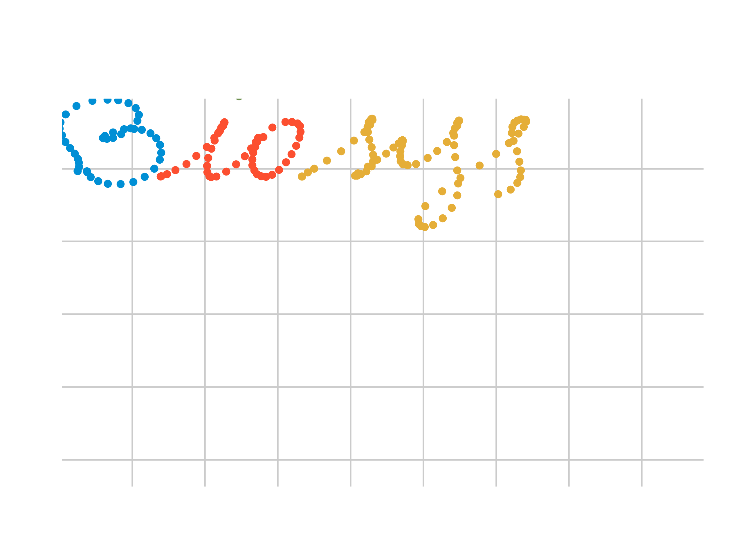
Is the starting point relevant?
It's true that it can be seen as a biometrical trait, but it's extremely variable: it can not be the primary factor used to recognize users.
We wanted to study how much the starting point is important, so we created new time series, shifting each word to the top left corner.
Now we have six time series to work on!

Slide 15
How does the system work?
Dataset
Feature extractor
Features
SVM
Random split
Learning process
Training set
Test set
Trained SVM
Testing process
Results

Slide 16
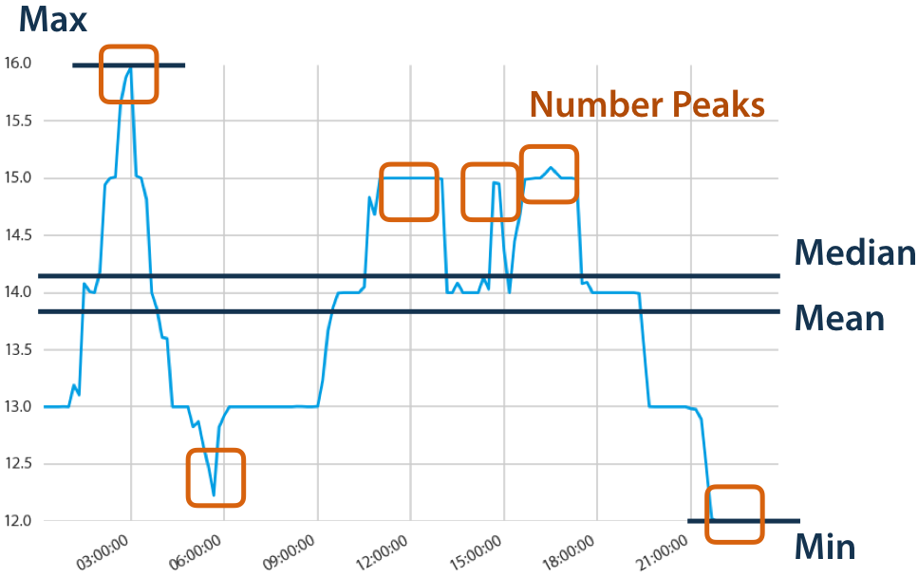
How do we extract features?
We use tsfresh to extract features from the time series.
It can automatically extract features from a time series and detect which features are discriminative.
From the movement points we are able to extract about 2114 discriminative features, involving x, y and connected component values.
A single word can be represented as the features extracted from: movement points, touch up points, touch down point and their shifted version

Slide 17
How is the data split?
We decided to do a balanced split of the data with:
70% training set
30% test set
For each user we'll perform the training on 22 words and test the performances on the remaining 10 words.
This will be done for every available representation of the word!
Remember that, from here on, a word is just a set of couples: (feature, value)
We have six of those sets for each word!

Slide 18
What is an SVM?
Support Vector Machines can solve binary classification problems, finding a separating hyperplane in order to linearly separate the data.
If the data is not linearly separable a kernel trick can be used and, moreover, outliners can be handled with the use of slack variables.
We use an OneVsRest approach to solve multiclass problems:
It is trained an SVM for each class
The final decision is taken through a majority vote
In scikit-learn it is possible to get confidences of each possible class with a process of probability calibration (Platt calibration)
We'll use scikit-learn for the learning phase

Slide 19
Which SVMs do we use?
We train an SVM for each available representation of a word.
We get 6 different SVMs, that works on different types of points:
MOVEMENT: trained on the features extracted from the movement points
UP: trained on the features extracted from the touch up points
DOWN: trained on the features extracted from the touch down points
XY_MOVEMENT: trained on the features extracted from the shifted movement points
XY_UP: trained on the features extracted from the shifted touch up points
XY_DOWN: trained on the features extracted from the shifted touch down points
The italic and block letters handwriting are completely independent: we have a total of 12 SVMs to train for each simulation

Slide 20
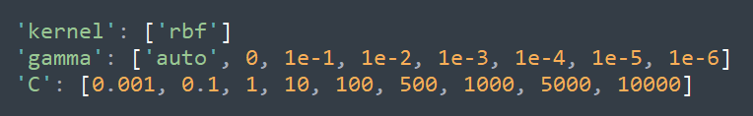
SVMs tuning
Each one of the SVM is tuned independently from the others and their parameters are optimized by a 5-fold cross-validated grid search.
The grid in which the best parameters are searched is the following:
Where auto means: $\frac{1}{number of classes}$ = $\frac{1}{32}$

Slide 21
Ensemble methods
At this point we have different SVMs that are able to recognize users working on different features of the same word.
Let's combine them!
We created three main method to combine these simple SVMs:
Majority: takes the majority of the predictions. The probabilities returned are the one of the SVM with the highest confidence in the final result
Average: returns a vector of probabilities where each value is the average of the probability computed by the simple SVMs
Weighted average: given a weight, it is the same as Average but performs a weighted average giving more importance to the movement points SVM
We applied the strategies to the normal features, the shifted features and they all together.
We have a total of 9 ensemble methods.

Slide 22
How do we evaluate the system?
We wanted to test the system in identification and verification mode.
Just to remember…
Identification: the system, given a sample word, tries to guess who is the author of that word
Verification: the system, given a couple (sample word, user), tries to guess if the user is the author of that word or not

Slide 23
How do we do Identification?
The system, given a sample word, can return a ranking of the classes: from the most probable user to the most improbable one.
Given these rankings, it is straightforward to plot the CMC curves to evaluate the performances for the identification task!

Slide 24
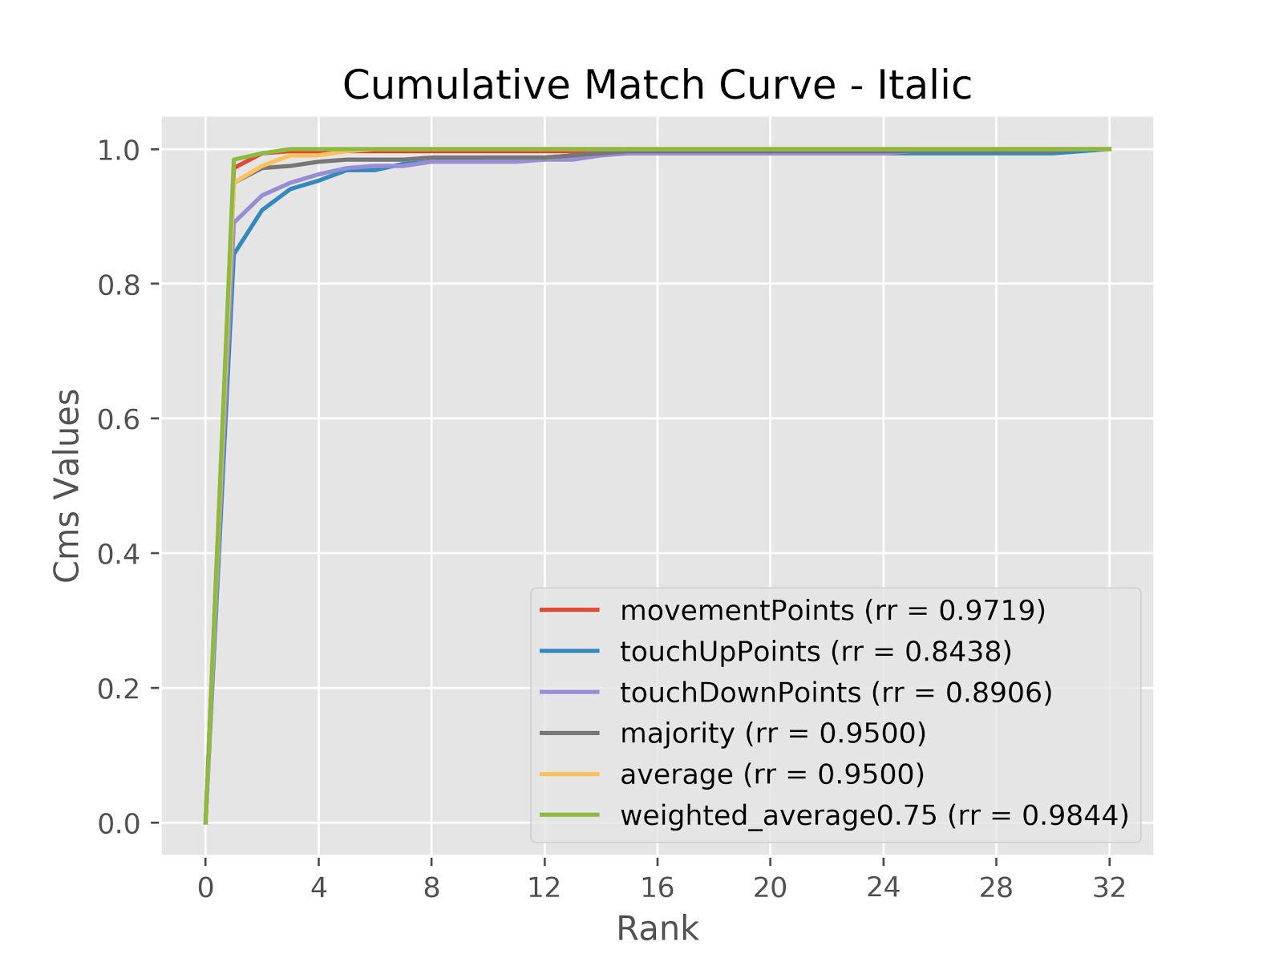
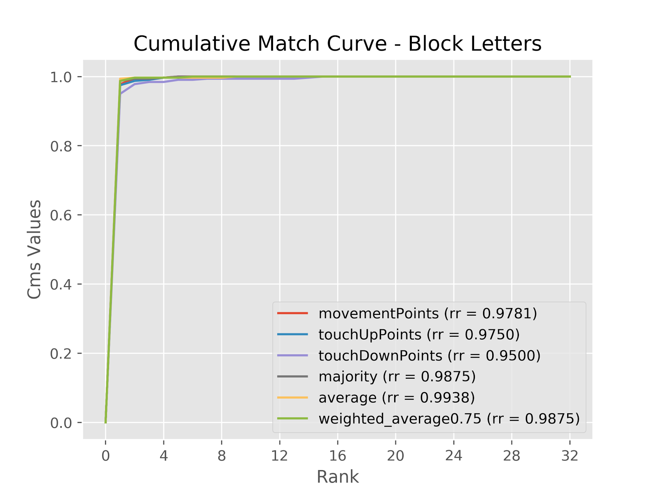
Identification results overview

Slide 25
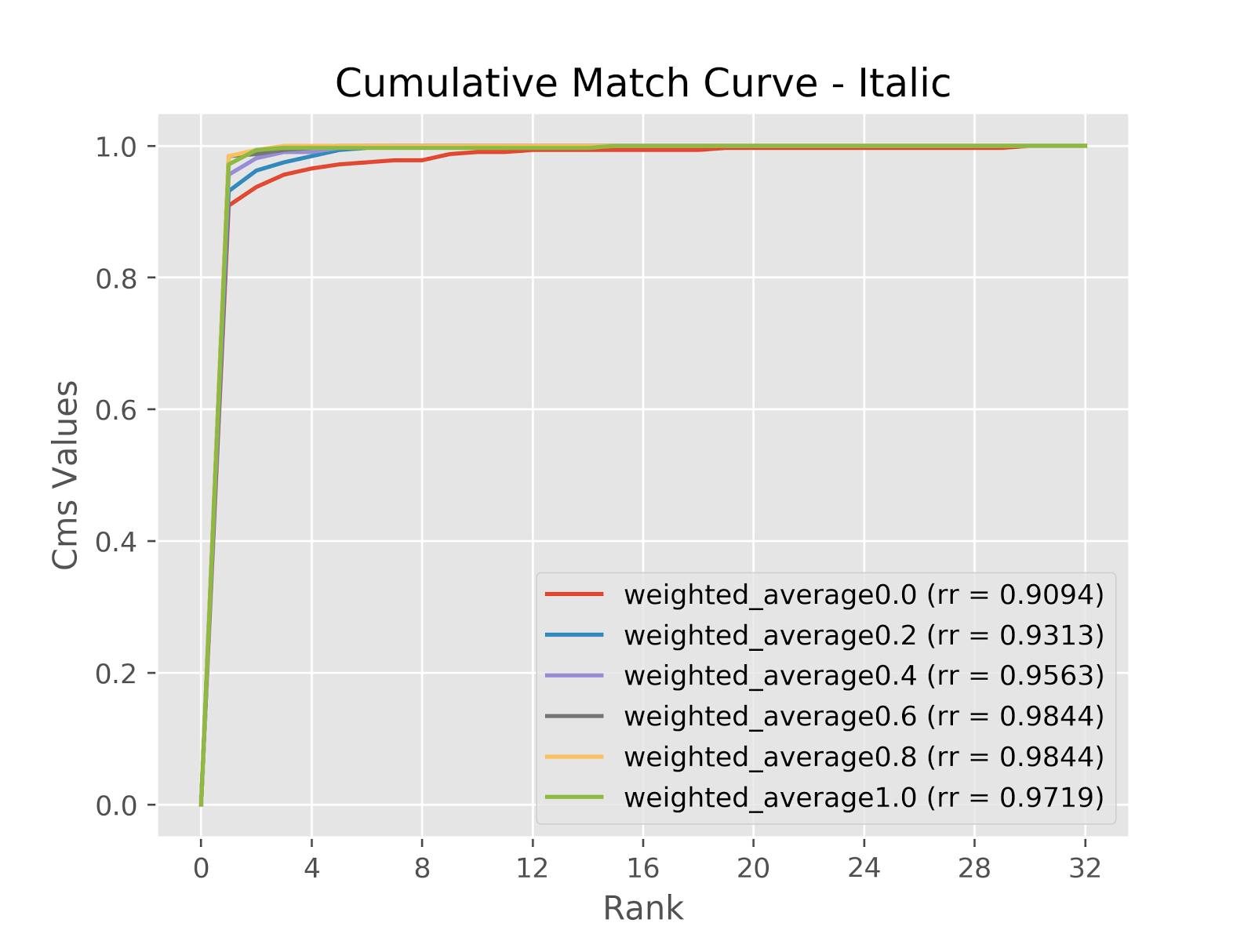
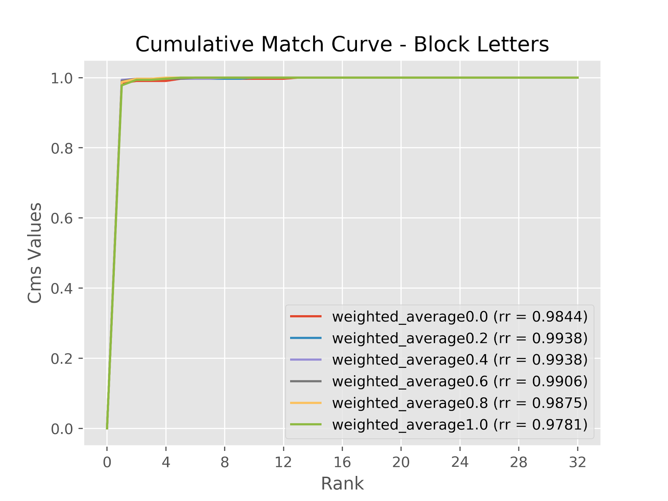
Identification different weights for the movement SVM

Slide 26
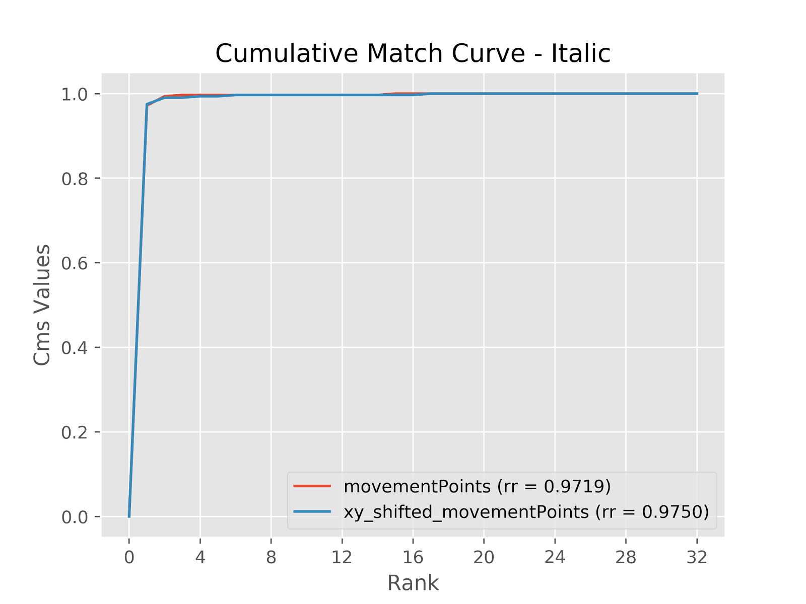
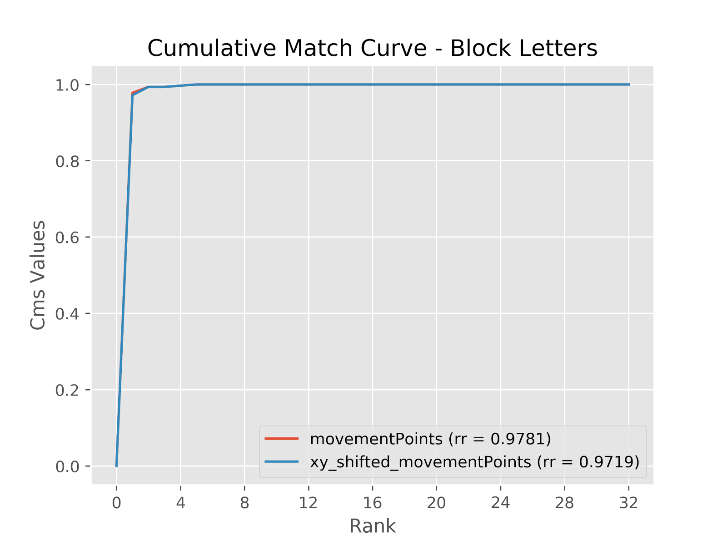
Identification influence of the starting point

Slide 27
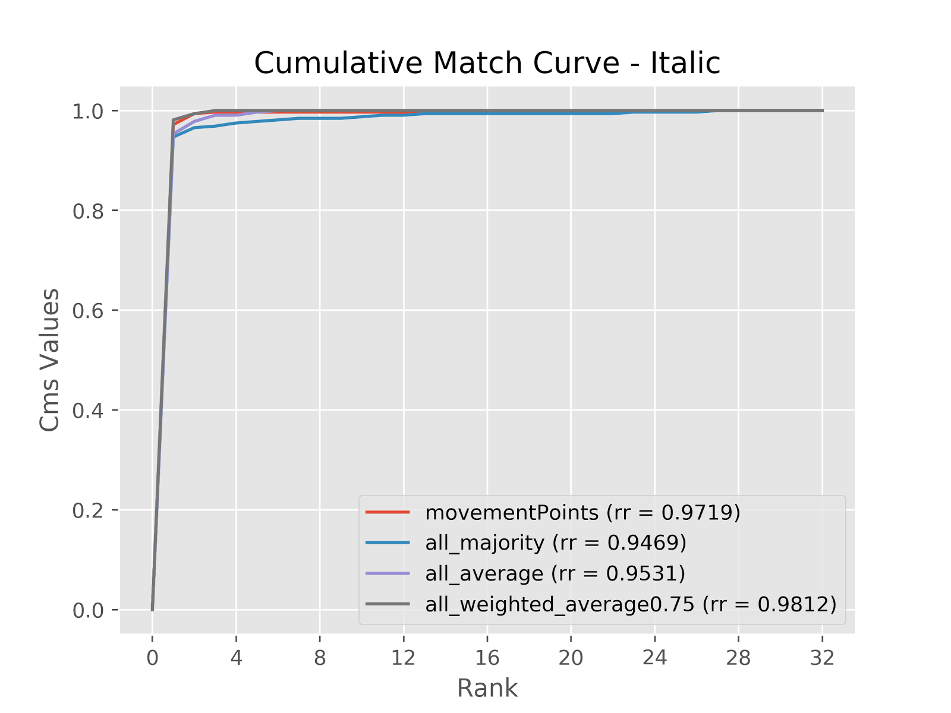
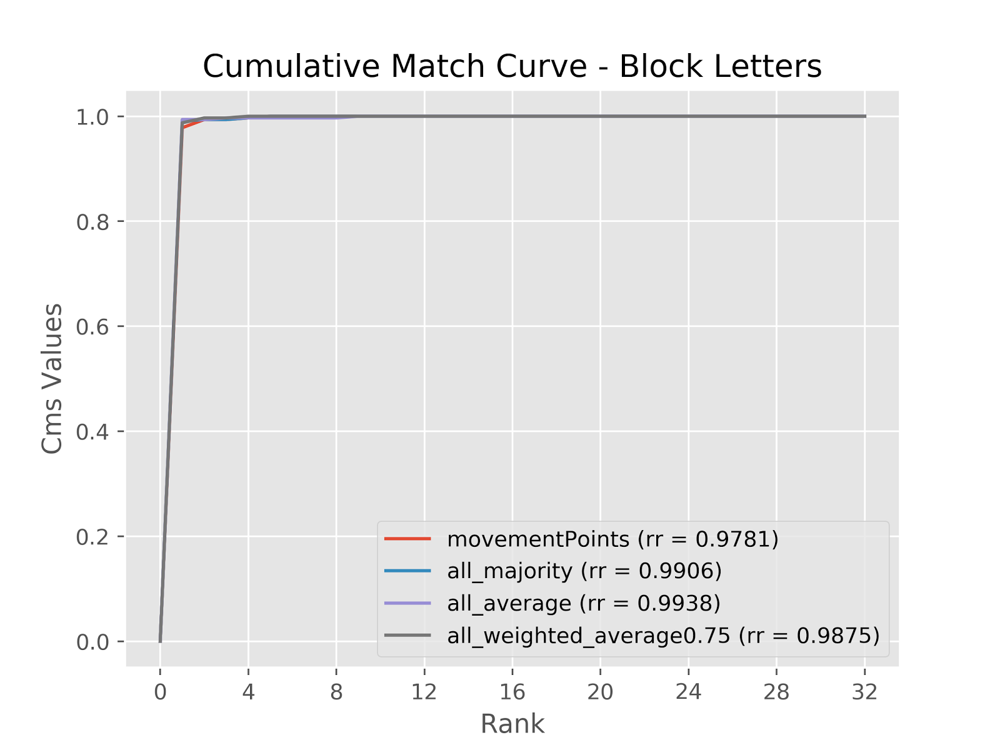
Identification the global ensemble methods

Slide 28
How do we do Verification?
Given a threshold, the verification of the couple (sample X, user U) is positive if the probability of the sample X being of class U is greater than the threshold.
We need to generate tests in the form of:
((sample word, claimed user), true author)
The verification must be positive if the claimed user is the same as the true author, false otherwise.
We will analyze the performances with ROC and FAR vs FRR curves!

Slide 29
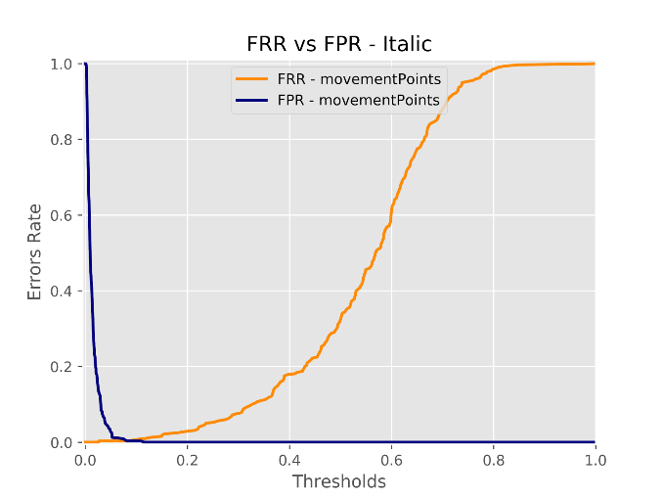

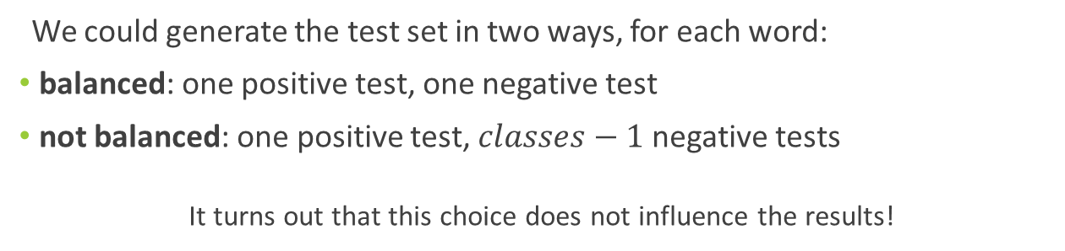
Verification how to generate the test set
We could generate the test set in two ways, for each word:
balanced: one positive test, one negative test
not balanced: one positive test, $classes−1$ negative tests
It turns out that this choice does not influence the results!
balanced
not balanced
This line is smoother and probably better approximates the real unknown curve
We will use only the not balanced!

Slide 30
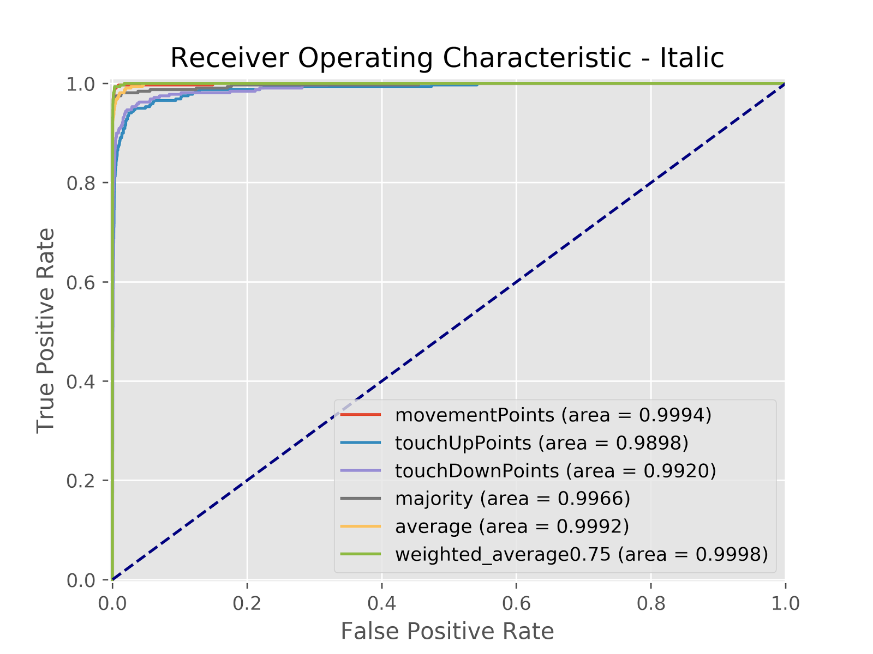
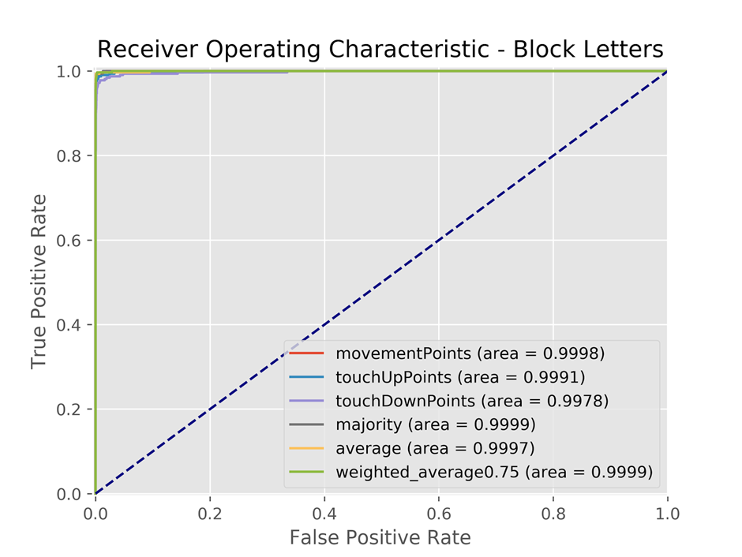
Verification results overview

Slide 31
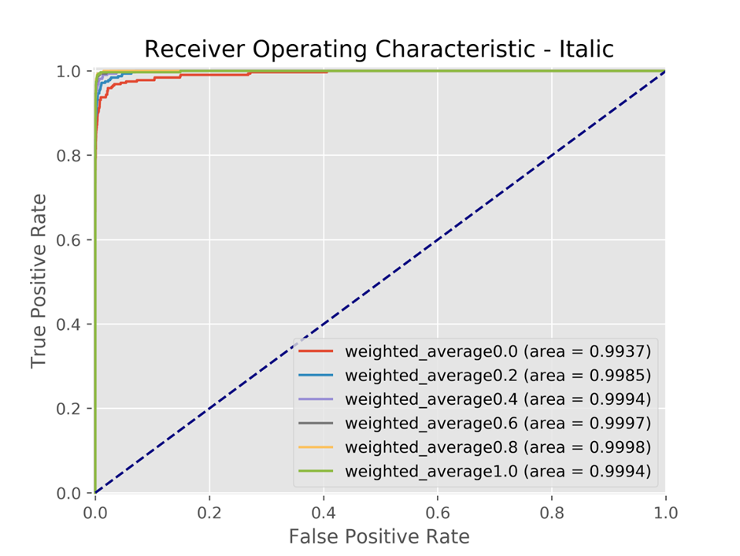
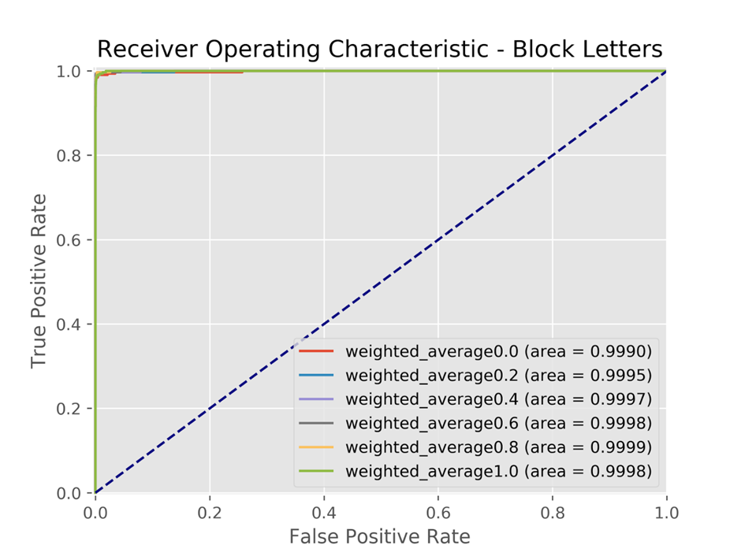
Verification different weights for the movement SVM

Slide 32
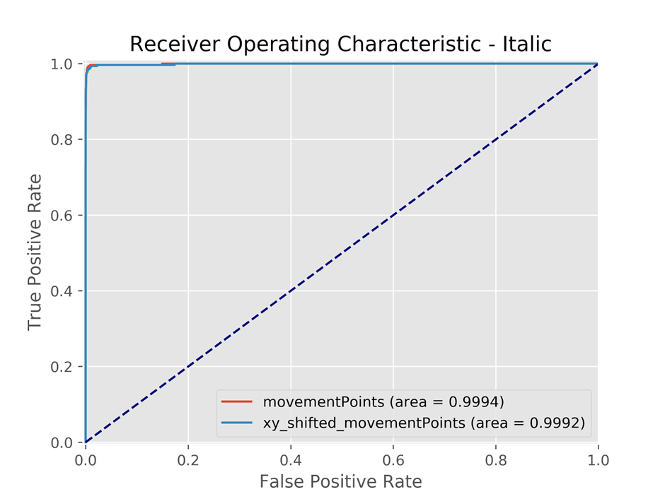
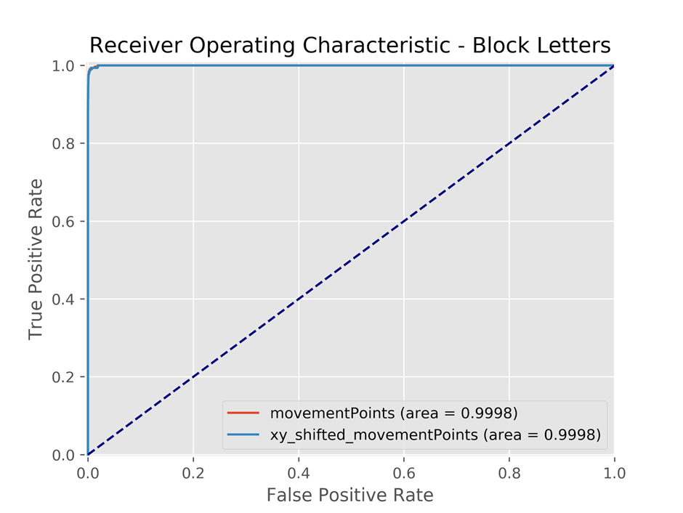
Verification influence of the starting point

Slide 33
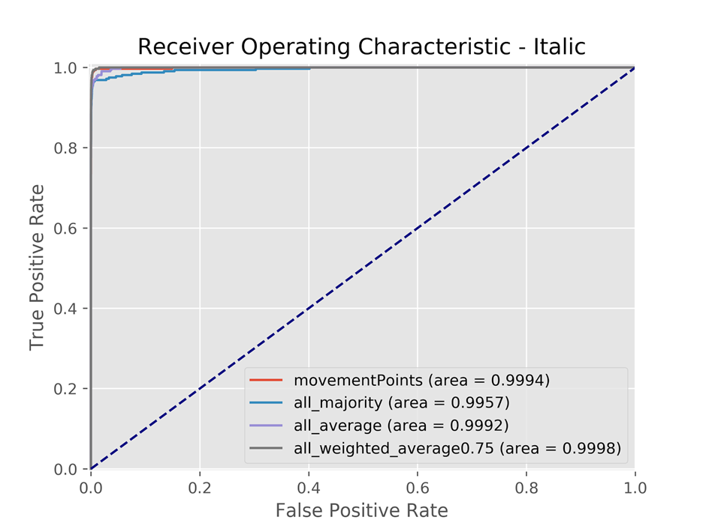
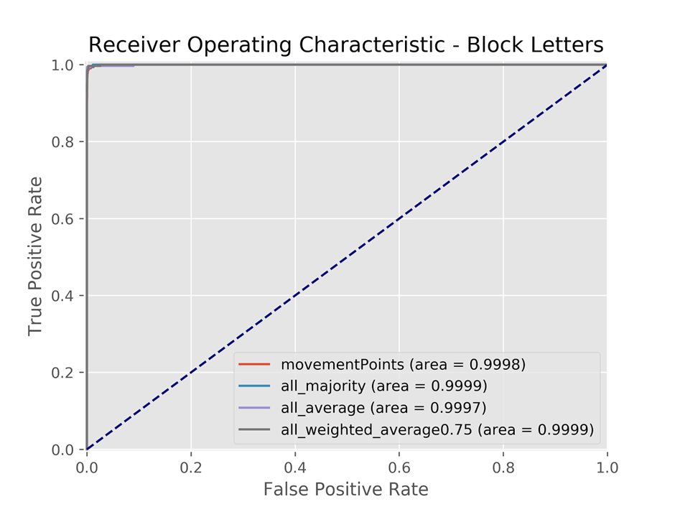
Verification the global ensemble methods

Slide 34
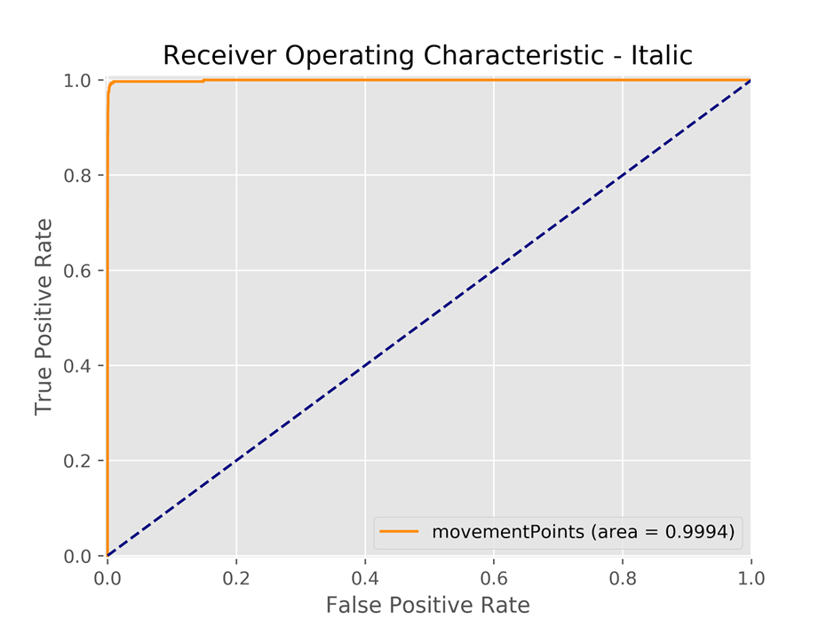

Verification a comparison: ROC

Slide 35

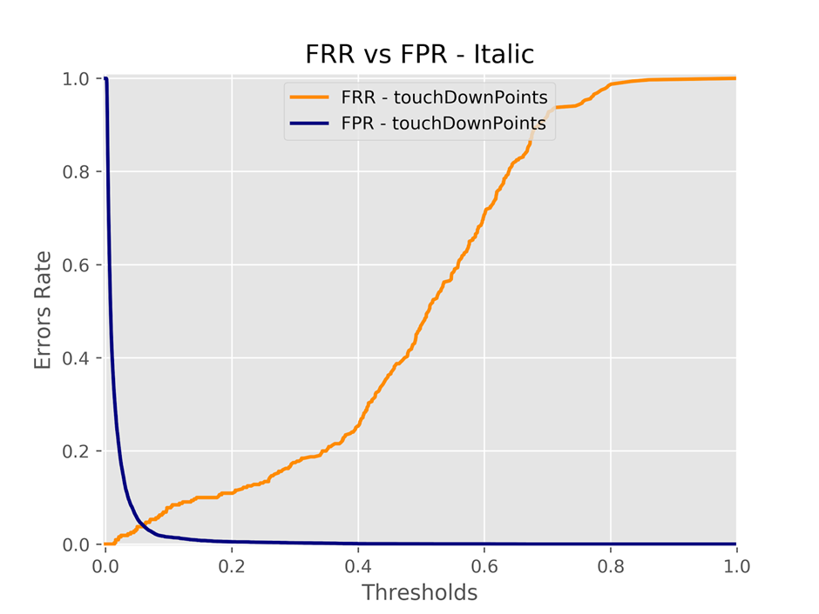
Verification a comparison: FRR vs FPR

Slide 36
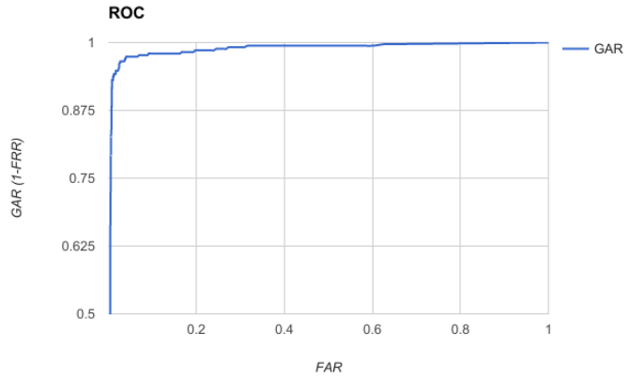
Comparison with Biopen ROC

Slide 37

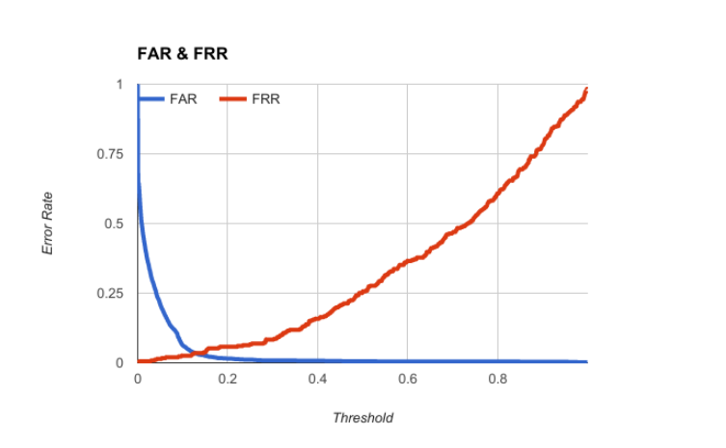
Comparison with Biopen FRR vs FPR

Slide 38
Conclusions
The system works very well both in identification and in verification.
Performances decrease only when the time series are too short and there isn’t enough information (e.g. the italic touch down series, because there are too few connected components).
In real word applications the performances would probably decrease due to a greater number of difficulties, but our results are encouraging!

Slide 39
Future works
Some ideas about what to do in the future:
Testing on dataset gathered after some time on the same users
Testing on a bigger dataset to see if the performances are stable
Testing on different approaches of SVM (OVO instead of the OVR)
Testing different machine learning algorithms, that may give a better estimation of probabilities
Testing boosting techniques, as Adaboost, that may perform well if there is some user particularly difficult to recognize
Try to use a similar approach to detect age range or gender
Explore a KNN DTW approach
☺

